Slide 1
Intervening in youth unemployment and precariousness: Alternative framings and approaches for Entrepreneurship
Joan DeJaeghere
University of Minnesota
deja0003@umn.edu
Nelson Mandela University
Port Elizabeth, South Africa
21 Sept, 2018
Notes:
Thank. Lesley Powell, Vice Chancellor, and Prof. Keet
Acknowledge David Chapman, co-PI; Nancy Pellowski-Wiger and Acacia Nikoi – project directors; and the many graduate students from the U of MN and the researchers from Tanzania who assisted with this project over 6 years. The views expressed here – and all errors - are mine alone; they do not necessarily reflect the position or policy of the Mastercard Foundation or its partners.

Slide 2
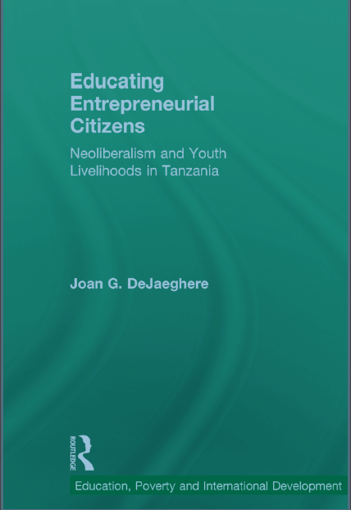
Background
I’m a researcher of education and development in the Comparative and International Development Education program at the University of Minnesota
I have been conducting evaluations and research on initiatives to redress education inequalities in sub-Saharan African for about 15 years.
I led a 7-year study of an entrepreneurship education and training program implemented in TZ (and in Uganda and Kenya), and a 3-year study of an entrepreneurship program in Cape Town in partnership with The Mastercard Foundation.
Notes:
So I come here with an understanding of examining education systems comparatively, and of different research projects that have looked at educational innovations or interventions aimed at addressing inequalities.

Slide 3
Key concerns and points of departure
How do social, economic and political structures reproduce educational inequality
How are discourses and interventions used to shape youth’s lives as citizens, and what kind of citizens are we shaping through education
What are the forms that neoliberalism and neocolonialism take in shaping educational interventions to redress inequalities – e.g., entrepreneurship
What are the local ways of knowing/being that reshape educational interventions
How can educational practices and pedagogies be transformative towards greater justice

Slide 4
The Discourse of Entrepreneurship
Permanent Secretary in the Tanzanian Prime Minister’s Office responsible for Policy and Coordination of Government Business recently said: “This large population of youths in the country should be properly trained and equipped because it is an engine for economic growth and by giving them entrepreneurship skills, business techniques and life skills they will become more productive hence contributing to GDP growth.”
Want to change the world? Start a business. – Jonathan Clarke, entrepreneur (in Giridharadas, Winners Take All, 2018)
Notes:
Chambi Chachage – a recent dissertation on the history of entrepreneurship/entrepreneurial elite in Dar es Salaam

Slide 5
Entrepreneurship has become the solution for
youth unemployment and the savior for economic growth.
And it is deemed a critical area of study in education.
But is it? And how?

Slide 6
Questions explored in the book
Does entrepreneurship education produce neoliberal enterprising citizens, or can it foster equity and wellbeing?
How do discourses, goals and content of entrepreneurship education get adapted and changed as they encounter local realities and social contexts of youth?
Notes:
I am concerned with this question of the kind of citizen being produced because not participating in the labor market is a means of exclusion from society. James Ferguson refers to this as “work membership”
Questioning and problematizing if and how entrepreneurship contributes to economic and social wellbeing
Consider multiple and alternative forms of economies
Reframe how entrepreneurship education/training can foster youth wellbeing

Slide 7
Analytical frameworks
Different forms/purposes of entrepreneurship education: for economic growth, for poverty alleviation or for equity and wellbeing
Double meanings of neo/liberalism as enacted through EE (Ferguson, 2013; Muehlebach, 2012);
Local political, social and economic relations shape EE as it is enacted in our daily lives
Notes:
Chapter 1-2 lay out the key concepts of neoliberalism, liberalism as it relates to assumptions about education and development
Chap. 3 – analyzes different entrepreneurship programs – their purposes and approaches – EE for econ. Growth and for poverty alleviation are undergirded with liberal and neoliberal assumptions; in the final part of the chapter I suggest how a capability approach would frame entrepreneurship education – with a greater focus on governments’ roles; on social benefits and supports, and on

Slide 8
Friction – Anna Tsing
The encounter between global discourses and practices and local discourses and practices. Global discourses and practices are hegemonic, but there are cracks in hegemony. When they meet local practices, a friction is created – in that friction, something is lost and gained; it changes. What is produced in the encounter can be productive – positive, or reproductive.

Slide 9
Different Forms/purposes of entrepreneurship
As productive use of resources to produce a profit, to reinvest and to grow the economy (Schumpeter, 1934)
Includes innovation and creativity – but for what end?
As a tool for poverty alleviation
Entrepreneurship as necessity; economic survival (World Bank, 2014)
For human development and wellbeing
For sustainable development, entrepreneurship requires supportive social (education, labor, social protection) policies (Naude, 2014)
Notes:
World Bank – in a review of their own programs they recognized it was not a driver of growth; high failure rates and main driver of growth remains in the formal employment sector; of course the formal and informal sectors are changing with much informality in the formal, and a formalization of informal

Slide 10
Is entrepreneurship education a quintessential neoliberal technique or something else?

Slide 11
Neoliberal economies and governing
Global capitalist economy
Singular focus on growth and profit, production of inequality
Value added in global supply chains rather than social and political value of enterprises
Financial capital rather than social and cultural capital
Neoliberal governing - techniques and practices that reproduce enterprising selves
Policies that promote precarity – employment and wage laws
Social practices – hustling, mixed livelihoods, risk responsibility
Necessity entrepreneurship
Education for skills and life skills that foster resilience, grit
Notes:
Entrepreneurship in neoliberal framing -
Gibson-Graham – there are many types of economies – and need to determine what is valued and the practices of these economies
Policies promting precarity – in TZ – even the requirement that any formal sector job requires a secondary school certificate exacerbates inequalities

Slide 12
Ways neoliberalism influences education
Teaching skills for the market (and specific sectors)
Teaching life skills to be responsible for one’s own livelihood, and the risks
Creating producers and consumers, rather than social and political members

Slide 13
Alternative economies and ways of governing
Community economies, moral economies (see Gibson-Graham)
Governing technologies/policies – community-based enterprises, cooperatives, promoting solidarity and social relations
Social skills as part of education – recognition and inclusion, community care,
Notes:
From a socialist – and Ujamaa - perspective that influenced the enactment of this entrepreneurial intervention
NOTE: There are negative sides to other economies and social institutions - they can also be exclusionary

Slide 14
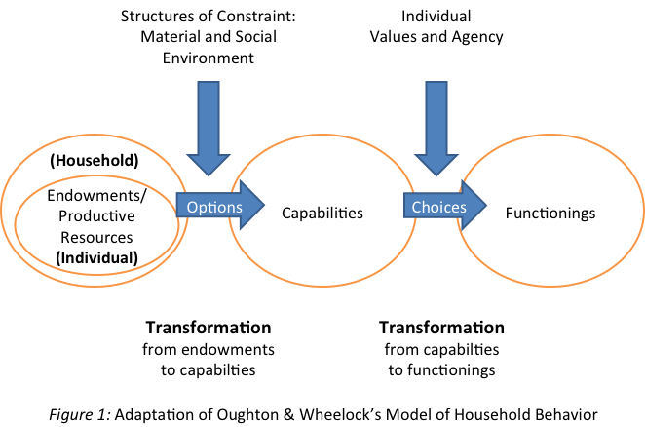
Capability approach to education and to EE: a focus on wellbeing

Slide 15
Entrepreneurship Education for Wellbeing
Considers what participants value for their future work and supports how they can achieve valued livelihoods
Considers different kinds of economies– local, global, capitalist and moral
Identifies knowledge and skills that are important in social context – e.g., social relations of reciprocity and solidarity
Requires additional policies and support mechanism to transform constraints and achieve desired outcomes – financing, policies to support risk-taking and loss
Notes:
Acknowledges that youth/student or entreprneeur has different conditions that support or constrain them

Slide 16
The youth livelihoods project: Five-year Longitudinal study
Youth were between 15-25 years old
Some youth had not completed secondary education – this entrepreneurship training program targeted vocational skills, apprenticeship, and other work and life skills
Some youth were in secondary school – this program included a business club where they applied theory to practice, learned new vocational, business and financial skills
Another program included students who completed secondary school - prepared them with formal labor market employment
Goals, from program and donor perspectives, were to start micro-enterprises, earn money, save and reinvest

Slide 17
What did these education/training programs look like in practice, and what were their long-term impacts?

Slide 18
Produced “entrepreneurial citizens” – double meanings
Responsibilization and recognition: learning skills and being recognized as skilled/educated
Participation (in capital and moral economies): creating enterprises and supporting community development
Creating value and being valued
Notes:
Productive sense of value – and Ferguson’s work membership and also inclusion in society and being recognized (in N. Fraser’s use of the term)

Slide 19
Responsibilization and Recognition (Inclusion)
Learning skills
RECOGNIZED AS SKILLED
technical and life skills – to be timely, responsible workers; to be independent and resilient, despite a highly volatile labor market and economy
Responsibilization of young people into enterprising - and hustling – workers
being regarded by others as a skilled or educated person
Developing trust and recognition with others and in the community

Slide 20
BEING RECOGNIZED – INCLUsion
If the community doesn’t know you, they see you like those other youth (idle, stealing) . . . You can go out and ask for work . . . [but] they may not hire you because they have grouped you with all the other youth. (Sudi, a young man who completed Standard 7 and later trained as a mechanic)
But now, they value [and respect] me because I can give advice to other youth, and they trust me and give me work. I am a hard worker. I can also catalyze change or help in my community.

Slide 21
Participation in capital and moral economies
Supporting community development
Creating enterprises
New products and markets
Profit
Reinvestment in business
Developing jobs
But in reality:
Multiple livelihoods
Unstable earnings
Reciprocity
Self-reliance – supporting others for survival and wellbeing
Community economies – different use of profit for a valued good life (Gibson-Graham)

Slide 22
Entrepreneurship – embedded in social relations
We fundi have the practice of lending not cash, but items. For example, my friend came to borrow items from my workshop . . . And he will return it. So there is not interest/profit from this loan, but the person borrowing gets a profit from the work they are able to do. But even if you as the person who is lending the equipment don’t get any direct profit, you still help him as it could happen any day that you need help and he will help you.
- Jahi, a welder

Slide 23
Functionings: Creating value and being valued
Creating value (ECONOMIC)
Being valued (SOCIAL)
Valued-added enterprises in a global value chain
Profit and reinvestment
Valued being included in the community
Helping and supporting others

Slide 24
social value added, not only profit
I pay the municipal license and make some community contributions and donations. So for instance, when there is one ward leader whose mom died, I had to contribute (to the social fund). Also there’s one girl who couldn’t pay her school fees, so her uncle came by to ask us to help. So I contributed to her fees. Also there was a girl that I trained and I didn’t earn any money from her.
- Goma is a tailor who opened her own shop and proudly speaks about the “valued added” from her work.

Slide 25
HOW CAN EDUCATIONAL PRACTICES AND PEDAGOGIES INTENTIONALLY FOSTER:
RECOGNITION AND SOCIAL INCLUSION
COMMUNITY CARE AND SOCIAL VALUE
ALTERNATIVE AND MIXED ECONOMIES?

Slide 26
EDUCATIONAL PRACTICES FOR RECOGNITION AND INCLUSION
Identify psychological, social and economic practices that differentially exclude youth
Foster relationships between youth and others who ‘misrecognize’ them
Use educational pedagogies that value their life-world knowledge
Foster a thick sense of trust in our classrooms, and between university and community spaces

Slide 27
EDUCATIONAL PRACTICES FOR COMMUNITY CARE AND SOCIAL VALUE
Identify what youth value for their wellbeing, and what communities value
Foster solidarity and reciprocity in our classrooms, and through employment/entrepreneurial opportunities
Promote reciprocal relationships between youth and the community – especially future employers and policymakers

Slide 28
EDUCATIONAL PRACTICES FOR ALTERNATIVE AND MIXED ECONOMIES
Consider how the entrepreneurship curriculum teaches about social and public value
Develop community and business relationships that foster social value – including investing in the education of young people

Slide 29
Questions for Discussion
Do we know what different youth value for their futures, their wellbeing?
How do our educational practices and pedagogies foster their agency and achieving this wellbeing?
How do institutional policies and practices create opportunities for youth and the community to engage, so that youth are recognized and valued by the community and the community is known to the youth?
How are students’ and their studies linked with the needs and concerns of their communities?
What are the purposes of entrepreneurship education in the institution? What sort of citizen does it aim to foster?
How does entrepreneurship education curricula address the public good, and social value/s?

Slide 30
Thank you!
Comments and questions?
Podcast about the book: http://www.freshedpodcast.com/joandejaeghere/
deja0003@umn.edu

